Slide 1
Repetition Session 7
Course : COMP6056
Effective Period : September 2021

Slide 2
Sub Topics
Introduction to Repetition Structure
Condition controlled loop
Count control loop
Calculating a running total
Sentinels
Nested Loop

Slide 3
These slides have been adapted from: Gaddis, T. (2019). Starting Out with Programming Logic and Design 5^{th.} ISBN: 978-0-13-480115-5 Chapter 5
Acknowledgement

Slide 4
Learning Objectives
At the end of this lecture, students are able to:
LO1: To explain the uses of repetition structure
LO2: To write pseudo-code to solve problem containing repetitions

Slide 5
Introduction to Repetition Structure
A repetition structure causes a statement or set of statements to execute repeatedly
Allow a programmer to avoid duplicate code.
Duplicate code makes a program large.
Write a long sequence of statements is time consuming.
If part of the duplicate code has to be corrected or changed, then the change has to be done many times.
Gaddis, T., Starting Out With Programming Logic and Design, 5 ed, ISBN: 978-0-13-480115-5

Slide 6
Introduction to Repetition Structure
Instead of writing the same sequence of statements over and over, a better way to repeatedly perform an operation is to write the code for the operation once, and then place that code in a structure that makes the computer repeat it as many times as necessary.
This can be done with a repetition structure, which is more commonly known as a loop.
Gaddis, T., Starting Out With Programming Logic and Design, 5 ed, ISBN: 978-0-13-480115-5

Slide 7
Condition-Controlled Loops
While Loop
While a condition is true, do some task
Do-While Loop
Do some task, while condition is true
Do-Until Loop
Do some task, while a condition is false (or until it’s true)
With all loops, be careful not to create infinite loops – always provide a way to break out
Gaddis, T., Starting Out With Programming Logic and Design, 5 ed, ISBN: 978-0-13-480115-5

Slide 8
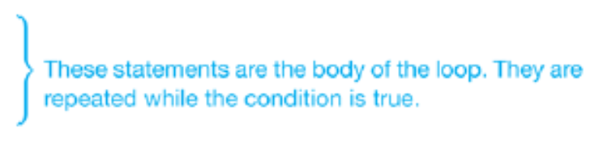
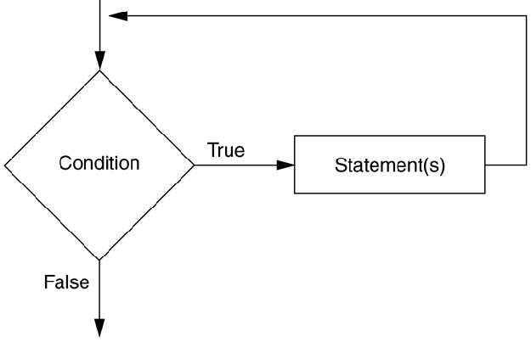
Condition-Controlled Loops
The While Loop – pretest loop
While condition
Statement
Statement
End While
Gaddis, T., Starting Out With Programming Logic and Design, 5 ed, ISBN: 978-0-13-480115-5

Slide 9
Condition-Controlled Loops
Writing Convention
Make sure the While clause and the End While clause are aligned.
Indent the statements in the body of the loop.
By indenting the statements in the body of the loop you visually set them apart from the surrounding code.
This makes your program easier to read and debug. Also, this is similar to the style that most programmers follow when writing loops in actual code.
Gaddis, T., Starting Out With Programming Logic and Design, 5 ed, ISBN: 978-0-13-480115-5

Slide 10
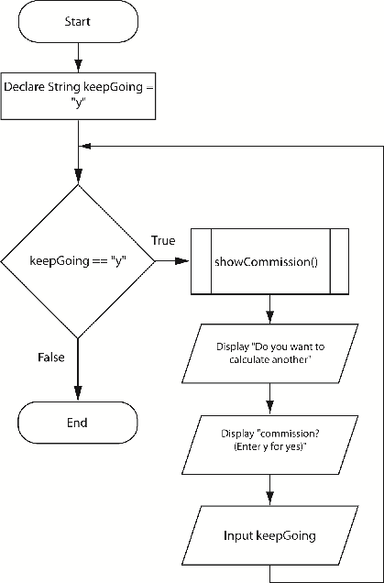
Condition-Controlled Loops
Working with Modules and Loops
To run a program multiple times, modules can be put within a loop
Gaddis, T., Starting Out With Programming Logic and Design, 5 ed, ISBN: 978-0-13-480115-5

Slide 11
WHILE
The WHILE construct is a leading decision loop which means the condition is tested before any statements are executed.
WHILE Format :
WHILE condition p is true
statement block
ENDWHILE
The following processing takes place :
The logical condition p is tested
If condition p is found to be true, the statements within the statement block are executed once. The delimiter ENDWHILE then triggers a return of control to the retesting of condition p
If condition p is still true, the statements are executed again, and so the repetition process continues until the condition is found to be false
If condition p is found to be false, control passes to the next statement after the delimiter ENDWHILE and no further processing takes place within the loop

Slide 12
WHILE
Consideration before designing a WHILE loop :
The testing of condition is at the beginning of the loop. Meaning that it may be necessary to perform some initial processing before it can be tested
The only way to terminate the loop is to render WHILE condition false

Slide 13
WHILE
Using WHILE to repeat a set of instructions an unknown number of times
When a trailer record or sentinel exists
The sentinel is a special record or value placed at the end of valid data to signify the end of the data
When a trailer record or sentinel does not exists
When there is no trailer record or sentinel to signify the end of the data, it is necessary to check for an end-of-file marker (EOF). The following expressions can be used :
WHILE more data
WHILE more records
WHILE records exist
WHILE NOT EOF

Slide 14
Example
Solution Algorithm
Consideration when establishing a solution algorithm :
a WHILE structure to control the reading of exam scores, until it reaches a score of 999
an accumulator for total scores, namely total_score
an accumulator for the total students, namely total_students

Slide 15
Example (cont’d)
B. Solution algorithm
Print_examination_scores
1 set total_score to zero
2 set total_students to zero
3 read name, exam_score
4 WHILE exam_score not = 999
5 add 1 to total_students
6 print name, exam_score
7 add exam_score to total_score
8 read name, exam_score
ENDWHILE
9 IF total_students not= zero THEN
average_score=total_score/total_students
Print average_score
ENDIF
END

Slide 16
Example (cont’d)
C. Desk checking
Input Data
Expected results
First name, and score of 50
second name, and score of 100
average score 75
 | First record | Second record | Third record
Score | 50 | 100 | 999

Slide 17
Example (cont’d)
C. Desk Checking
3. Desk Check Table

Slide 18
Condition-Controlled Loops
The Do-While Loop – posttest loop
Do
Statement
Statement
While condition
Gaddis, T., Starting Out With Programming Logic and Design, 5 ed, ISBN: 978-0-13-480115-5

Slide 19
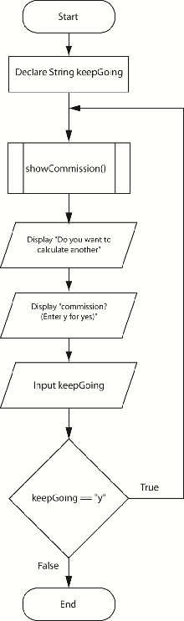
Condition-Controlled Loops
Writing Convention
Make sure the Do clause and the While clause are aligned.
Indent the statements in the body of the loop.
Gaddis, T., Starting Out With Programming Logic and Design, 5 ed, ISBN: 978-0-13-480115-5

Slide 20
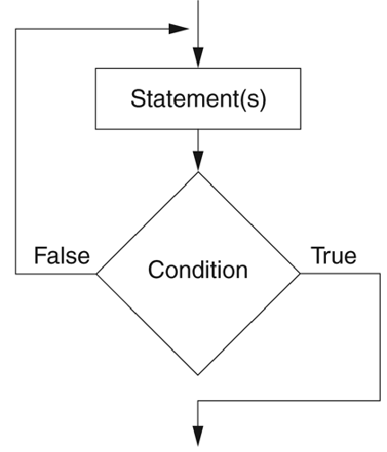
Condition-Controlled Loops
The Do-Until Loop
Loop iterates until a condition is true, but not all languages support this type of loop
Because the Do-Until loop is a posttest loop, it will always iterate at least one time.
Gaddis, T., Starting Out With Programming Logic and Design, 5 ed, ISBN: 978-0-13-480115-5

Slide 21
DO-UNTIL
a DO-UNTIL structure test the condition at the end of the loop. Meaning that the statements within the loop will be executed once before the condition is tested.
The format
DO
statement
statement
….
UNTIL

Slide 22
DO-UNTIL
The format
DO
statement
statement
….
UNTIL
Example:
A program is required to read a series of inventory records that contain an item number, an item description, and a stock figure. The last record in the file has an item number of zero. The program is to produce a low stock item reports, by printing only those records that have a stock figure of less than 20 items. a heading is to be printed at the top of the report and a total low stock count printed at the end

Slide 23
Example (cont’d)
Defining Diagram
B. Solution Algorithm
Requirements :
a DO-UNTIL to perform the repetition
an IF statement to select stock figures less than 20
an accumulator for total_low_stock_items
an extra IF, within the DO-UNTIL loop, to ensure the trailer record is not processed
Input | Processing | Output
Inventory record item_number item_description stock_figure | Read inventory records Select low stock items Print low stock records Print total low stock items | Heading Selected records item_number item_desciption stock_figure Total_low_stock_items

Slide 24
Example (cont’d)
B. Solution algorithm using REPEAT …UNTIL
Process_inventory_records
1 set total_low_stock_items to zero
2 print ‘Low Stock Items’ heading
DO
3 read inventory record
4 IF item_number > zero THEN
IF stock_figure < 20 THEN
print item_number, item_description, stock_figure
increment total_low_stock_items
ENDIF
ENDIF
5 UNTIL item_number = zero
6 Print total_low_stock_items
END

Slide 25
Example (cont’d)
C. Desk Checking
Input Data
Expected Result
Low Stock Items
8 (first record)
Total Low Stock Items = 1
 | First record | Second record | Third record
item_number | 123 | 124 | 0
Stock_figure | 8 | 25

Slide 26
Example (cont’d)
C. Desk Checking
3. Desk check table

Slide 27
Count-Controlled Loops
A count-controlled loop iterates a specific number of times
A for loop is best used for this situation
For counterVariable = startingValue to maxValue
statement
statement
End for
There is an Initialization, Test, and Increment expression that controls the loop
Gaddis, T., Starting Out With Programming Logic and Design, 5 ed, ISBN: 978-0-13-480115-5

Slide 28
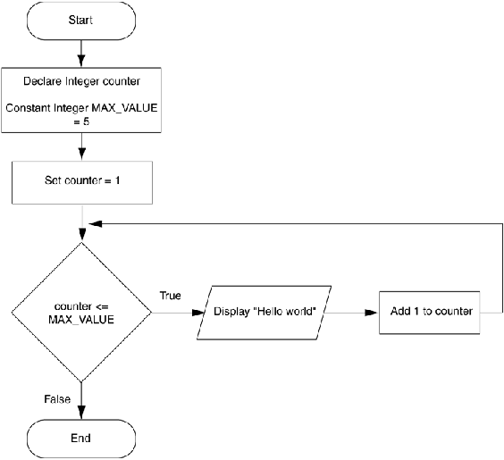
Count-Controlled Loops
For loops can also increment by more than one, count backwards by decrementing, or allow the user to control the number of interactions
Gaddis, T., Starting Out With Programming Logic and Design, 5 ed, ISBN: 978-0-13-480115-5

Slide 29
FOR repetition
Counted repetition occurs when the exact number of loop iteration is known in advance
The execution of the loop is controlled by a loop index, as follow
FOR loop_index = initial_value to final_value
statement block
ENDFOR
The FOR loop does more than repeat the statement block. It will :
Initialise the loop_index to the required initial_value
Increment the loop_index by 1 for each pass through the loop
test the value of loop_index at the beginning of each loop to ensure that it is within the stated range of values
Terminate the loop when the loop_index has exceeded the specified final_value

Slide 30
Example
Every day, a weather station receives 15 temperatures expressed in degrees Fahrenheit. A program is to be written that will accept each Fahrenheit temperature. Convert it to celcius and display the converted temperature to the screen. After 15 temperature have been processed, the words “All temperatures processed” are to be displayed on the screen

Slide 31
Example (cont’d)
Defining Diagram
Solution Algorithm
The solution will require a FOR loop and loop counter (temperature_count) to process the repetition
Input | Processing | Output
f_temp (15 temperatures) | Get Fahrenheit temperatures Convert temperatures Display Celcius temperatures Display screen message | c_temp (15 temperatures)

Slide 32
Example (cont’d)
B. Solution Algorithm
Fahrenheit_Celcius_conversion
1 FOR temperature_count = 1 to 15
2 prompt operator for f_temp
3 get f_temp
4 compute c_temp = (f_temp – 32) * 5/9
5 display c_temp
ENDFOR
6 display “All temperatures processed” to the screen
END

Slide 33
Example (cont’d)
C. Desk Checking
Input Data
Expected results
 | First data set | Second data set
f_temp | 32 | 50
 | First data set | Second data set
c_temp | 0 | 10

Slide 34
Example (cont’d)
C. Desk Checking
3. Desk Check table

Slide 35
Count-Controlled Loops
General loop concerns
Do not forget to initialize the loop control variable
Do not forget to modify the loop control variable
Many loops are interchangeable, but generally
Use while loop when loop may not have to process
Use do while when it must process at least once
Use for loop with specific number of iterations
Gaddis, T., Starting Out With Programming Logic and Design, 5 ed, ISBN: 978-0-13-480115-5

Slide 36
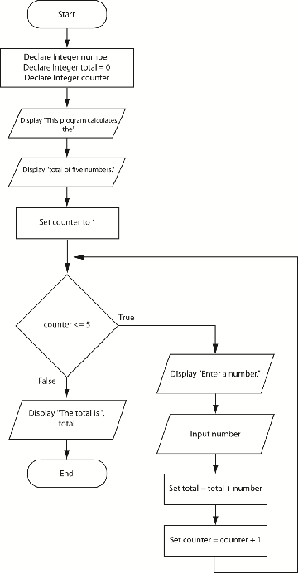
Calculating a Running Total
A running total is a sum of number that accumulates with each iteration of a loop
Gaddis, T., Starting Out With Programming Logic and Design, 5 ed, ISBN: 978-0-13-480115-5

Slide 37
Sentinels
A sentinel is a special value that marks the end of a list of values, used as stop values for loops
How it can be done
Ask the user at the end of each loop iteration, if there is another value to process
Ask the user at the beginning of the loop, how many times the loop should process
Gaddis, T., Starting Out With Programming Logic and Design, 5 ed, ISBN: 978-0-13-480115-5

Slide 38
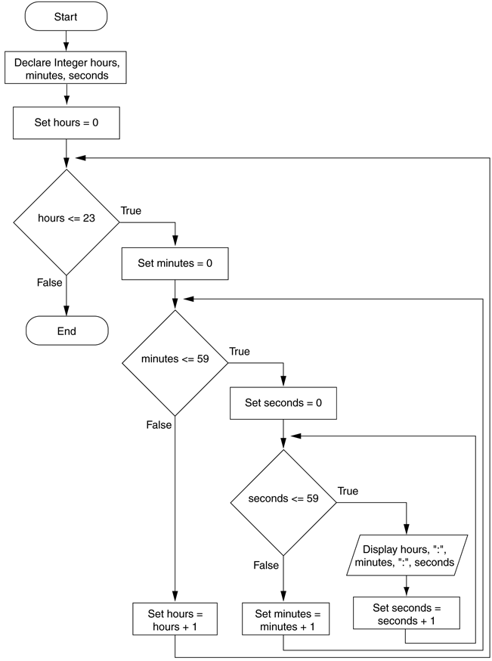
Nested Loops
All loops can be nested, that is, a loop inside of a loop
Gaddis, T., Starting Out With Programming Logic and Design, 5 ed, ISBN: 978-0-13-480115-5

Slide 39
Solution Algorithms
Each solution will be consist of :
Defining the problem
The control structures required
The solution algorithm
Desk checking

Slide 40
Example 1
A file of student records consist of ‘S’ records and ‘U’ records. A ‘S’ record contain the number, name, age, gender, address and attendance pattern – full time (F/T) or part time (P/T). A ‘U’ record contains the number and name of the unit or units in which the student has enrolled. There may be more than one ‘U’ record for each ‘S’ record. Design a solution algorithm that will read the file of students records and print only the student’s number, name and address on a ‘STUDENT LIST’

Slide 41
Solution of example 1
Defining Diagram
B. Control Structures required
A WHILE loop to control the repetition
An IF statement to select ‘S’ records
Input | Processing | Output
‘S’ records number name address age gender attendance_pattern ‘U’records | Print heading Read student records Select ‘S’ records Print selected records | Heading line Selected student records number name address

Slide 42
Solution of example 1 (cont’)
C. Solution algorithm
Print_student_records
print ‘STUDENT LIST’ heading
read student record
WHILE more record exist
IF student record =‘S’record THEN
print student_number, name, address
ENDIF
read student record
ENDWHILE
END

Slide 43
Example 2
Design a solution algorithm that will read the same student file as in problem 2 and produce a report of all female students who are enrolled part-time. The report is to be headed ‘FEMALE PART-TIME STUDENTS’ and is to show the student’s number, name, address and age.

Slide 44
Solution of example 2
Defining Diagram
Control structures required
A WHILE loop to control the repetition
An IF statement of statements to select ‘S’, female and part time (P/T)
Input | Processing | Output
‘S’ records number name address age gender attendance_pattern ‘U’ records | Print heading Read student records Select female P/T students Print selected records | Heading line Selected student records number name address age

Slide 45
Solution of example 2 (cont’d)
C. Solution algorithm
Produce_part_time_female_list
print ‘FEMALE PART TIME STUDENTS’ heading
read student records
WHILE more records
IF student record =‘S’ THEN
IF attendance_pattern = P/T THEN
IF gender = female THEN
print student_number, name, address, age
ENDIF
ENDIF
ENDIF
read student record
ENDWHILE
END

Slide 46
References
Gaddis, T. (2019). Starting Out with Programming Logic and Design 5th. ISBN: 978-0-13-480115-5

